Slide 1

Plugin’s what are they good for?
By: Daniel Greig

Slide 2

Daniel Greig
Tech/Team Lead at Earthling Interactive
CMS/Ecommerce Architect at Earthling Interactive
Co-organizer Madison Wordpress meetup
Have a pair of cats who think I spend way to much time in front of the computer and not loving them.

Slide 3
Wordpress
What does wordpress do out of the box

Slide 4
Plugin?
A plugin is a piece of software containing a group of functions that can be added to a WordPress website. They can extend functionality or add new features to your WordPress websites.
-https://www.wpbeginner.com/glossary/plugin/

Slide 5

Plugins
Custom post types
Short codes
Store
Events
Integration with 3rd party services
SEO customizations
Job Boards
Site optimization
Forms
Site backups
Magic

Slide 6
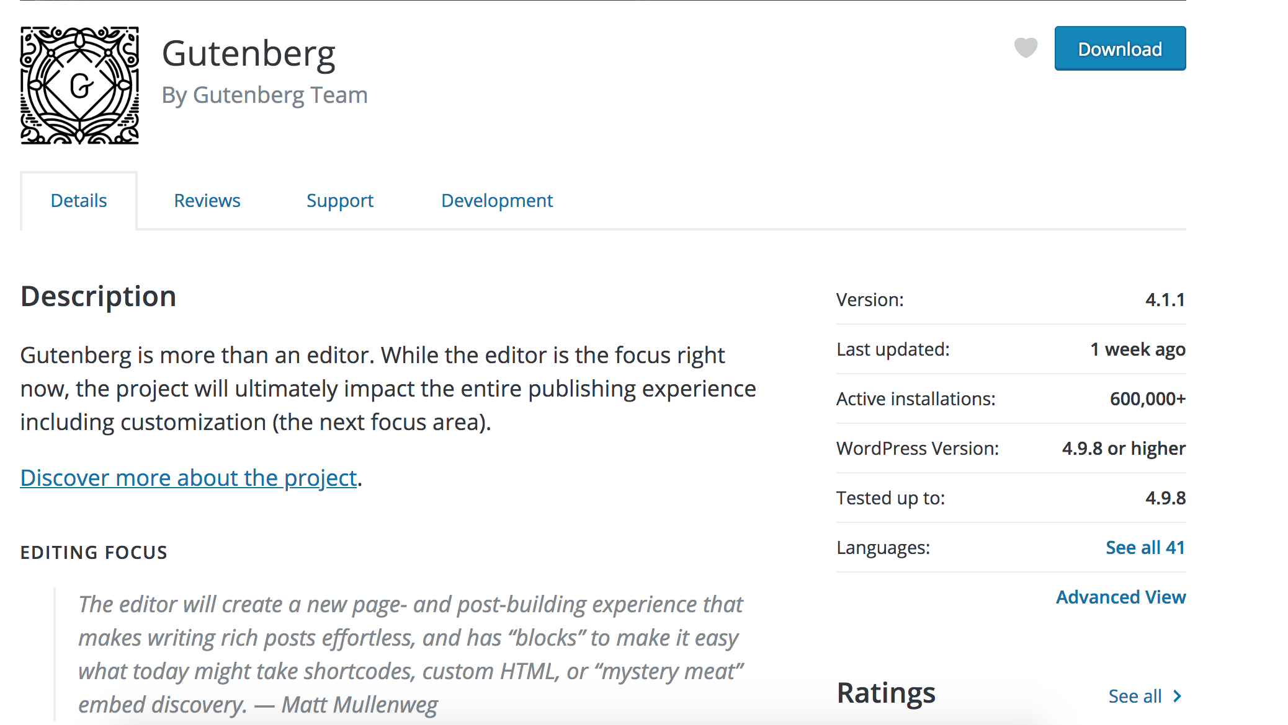
Wordpress Plugin Directory
55,501
Star Rating
Comments
Supported Verisons
Last updated
Active installs

Slide 7
Follow long at home
https://github.com/galieth/madisonphp-gutenberg

Slide 8
Plugin File Structure
<?php
/**
* Plugin Name: Madisonphp - Gutenberg
* Plugin URI: https://earthilnginteractive.com/madisonphp
* Description: A plugin that adjusts how gutenberg acts on our site.
* Version: 1.0
* Author: Earthling Interactive
* Author URI: https://earthlinginteractive.com
* License: http://www.gnu.org/licenses/old-licenses/gpl-2.0.html
*/
?>

Slide 9
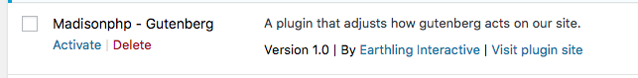
Plugin Name
Description
Version
Author
Plugin Uri
Author URI

Slide 10
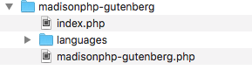
Additional Headers
* Text Domain: madisonphp-gutenberg
* Domain Path: /languages
* Network: true
The text domain must match the slug of the plugin.
echo __( Madison PHP is the best!', ' madisonphp-gutenberg ' );
Notes:
Used for internationalization
Folder inside the plugin where the .mo files live.
Must start with /
Network can only be set to True.

Slide 11
Header Gotchas
Version numbers (uses php version-compare)
For example, 1.02 is actually greater than 1.1.
1 < 1.0 < 1.0.0

Slide 12
Hooking into Wordpress
WordPress hooks are pre-defined points in the WordPress core code where developers can use them to inject an additional code or modify a variable.
Actions
Filters
Activate/Deactivate

Slide 13
Actions
Execute specific code at a specific event
50 action handlers (tags) happen on a standard page load
~700 are defined in wordpress core
Most common to hook into
init
save_post
wp_head
wp_footer
delete_post

Slide 14
Action Functions
has_action( string $tag, (optional) callable $function_to_check )
add_action( string $tag, callable $function_to_add, int $priority = 10, int $accepted_args = 1 )
did_action( string $tag )
remove_action( string $tag, string $function_to_remove, int $priority )
remove_all_actions( string $tag, int $priority )
doing_action( string $tag)
Notes:
has_action: if given a function_to_check returns the priority of it.
Priority: Lower numbers correspond with earlier execution, and functions with the same priority are executed in the order in which they were added to the action.
Did_action: Number of times action has been fired.
remove_action: Function Name and priority must Match
Remove_action: must be called inside a function and cannot be called directly in your plugin or theme
Doing_action: Checks if the action is currently running

Slide 15
Do Action
do_action( string $tag, $arg = " (,$arg2 = " … ) )
do_action_ref_array( string $tag, array $args );
$args = array( 'arg_1', true, 'foo', 'arg_4' );
do_action_ref_array( 'my_action', $args );
do_action( 'my_action', 'arg_1', true, 'foo', 'arg_4' );
Notes:
do_action: Used to call an action with args. Create your own actions

Slide 16
Filters
Used to modify variables
must return a value, which is the modified copy of the original value
has_filter()
add_filter()
apply_filters()
apply_filters_ref_array()
current_filter()
remove_filter()
remove_all_filters()
doing_filter()

Slide 17
Activate/Deactivate
Items run when the plugin is activated or deactivated.
register_activation_hook( string $file, callable $function )
register_uninstall_hook( string $file, callable $callback )
register_deactivation_hook( string $file, callable $function)

Slide 18
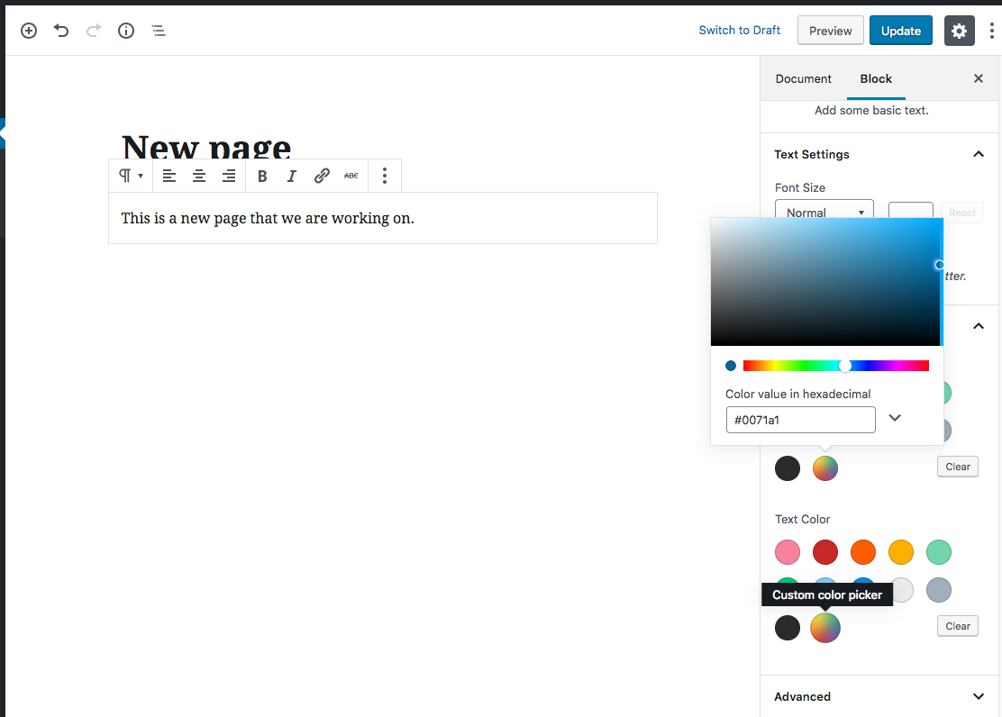
Gutenberg - Colors

Slide 19
Remove Custom Color
Function Name
function madison_gutenberg_disable_custom_colors() {
add_theme_support( 'disable-custom-colors' );
}
add_action( 'after_setup_theme', 'madison_gutenberg_disable_custom_colors' );
Action

Slide 20
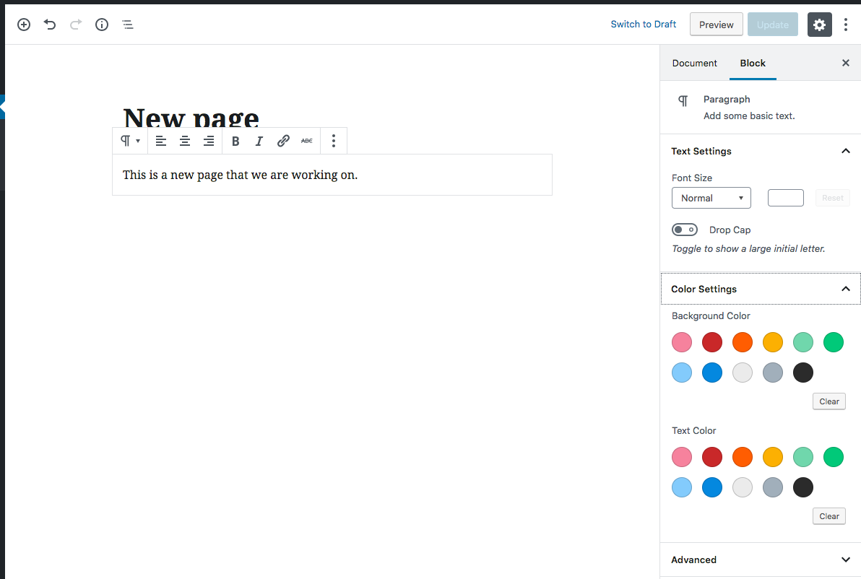
Result

Slide 21
Custom Color Palette
function madison_gutenberg_color_palette() {
add_theme_support(
'editor-color-palette', array(
array(
'name' => esc_html__( 'Black'),
'slug' => 'black',
'color' => '#2a2a2a’,
)
)
);
}
add_action( 'after_setup_theme', 'madison_gutenberg_color_palette' );

Slide 22
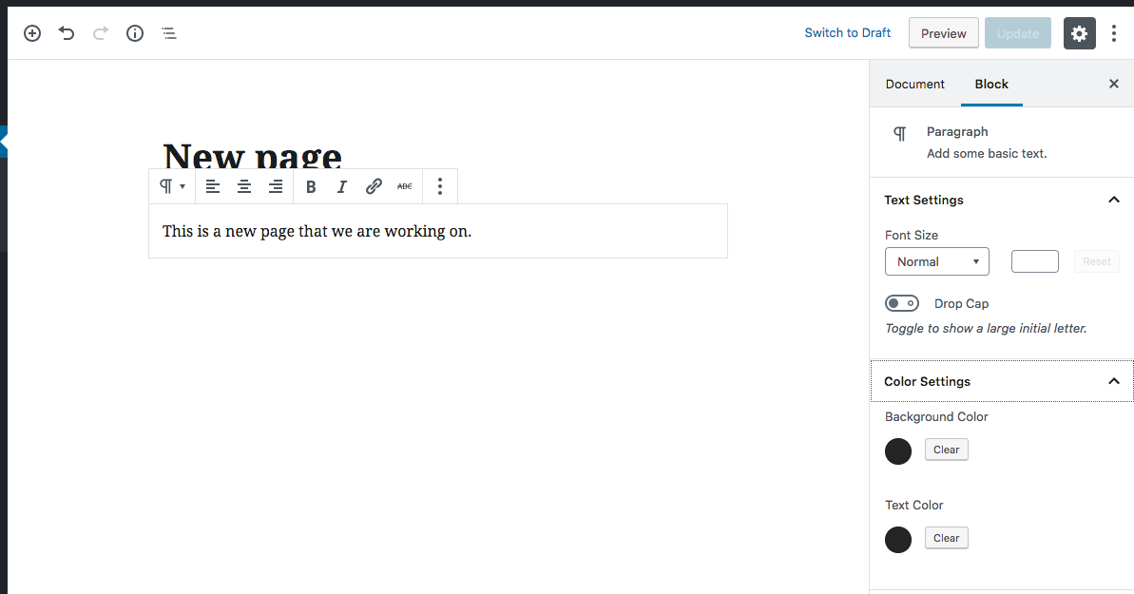
Results

Slide 23
CSS
wp_enqueue_style(
string $handle,
string $src = ’’,
array $deps = array(),
string|bool|null $ver = false,
string $media = 'all’
)
All, Print, Screen.
It will also take media queries, but I don’t suggest this
String: added to the end of the include (cache busting)
False: WP version is used
Null: Nothing is aadded
An array of handles this stylesheet depends on.
Path to the stylesheet (either full or from site root)
Unique Name

Slide 24
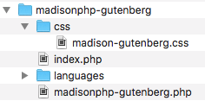
CSS in Action
wp_enqueue_style( 'madisonphp-gutenberg', plugins_url( '/css/madisonphp-gutenberg.css', __FILE__ ),array(), '1.2');

Slide 25
Options page
add_submenu_page(
string $parent_slug,
string $page_title,
string $menu_title,
string $capability,
string $menu_slug,
callable $function = ’’
)
(Optional) The function to be called to output the content for this page.
The slug name to refer to this menu by. Should be unique for this menu and only include lowercase alphanumeric, dashes, and underscores characters
User permission to be able to see the menu
Title tags of the page
The text to be used for the menu
The slug name for the parent menu

Slide 26
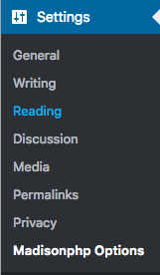
Options - Submenu
function soe_dmi_options_page()
{
add_submenu_page(
'options-general.php',
'Madisonphp Gutenberg Options',
'Madisonphp Options',
'manage_options',
'madisonphp-gutenberg',
'madisonphp_gutenberg_options_page_html'
);
}
add_action('admin_menu', 'madisonphp_gutenberg_options_page');

Slide 27
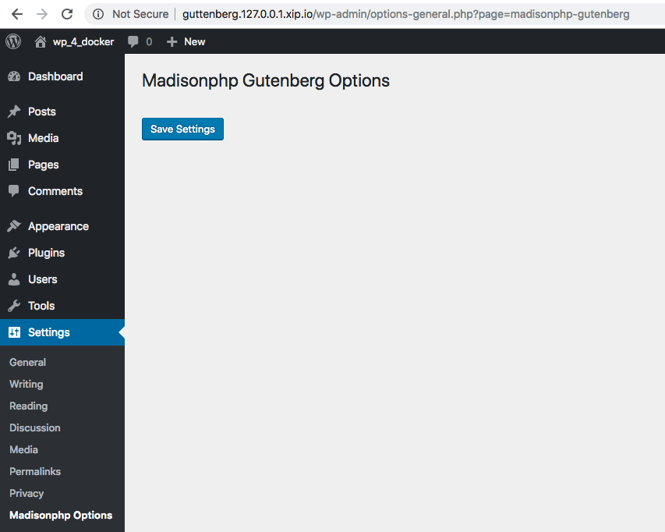
Options – Display function
function madisonphp_gutenberg_options_page_html() {
// check user capabilities
if (!current_user_can('manage_options')) {
return;
}?>
<div class="wrap">
<h1><?= esc_html(get_admin_page_title()); ?></h1>
<form action="options.php" method="post">
<?php submit_button('Save Settings’); ?>
</form>
</div>
<?php
}
Security check on their permissions
Disply of the page

Slide 28
Options - Adding
Register a setting/group
register_setting(
string $option_group,
string $option_name,
array $args = array()
)
'type’ (string) The type of data associated with this setting. Valid values are 'string', 'boolean', 'integer', and 'number'.
'description’ (string) A description of the data attached to this setting.
'sanitize_callback’ (callable) A callback function that sanitizes the option's value.
'show_in_rest’ (bool) Included in the REST API Data
'default’ (mixed) Default value when calling get_option().
register_setting( 'madisonphp_gutenberg, 'madisonphp_gutenberg_options' );
Options Group Name
Options Name

Slide 29
Options - Adding
Add Section
add_settings_section(
string $id,
string $title,
string $callback,
string $page
)
add_settings_section(
'madisonphp_gutenberg_section_color',
__( 'Color Settings.', 'madisonphp_gutenberg' ),
'madisonphp_gutenberg_section_color_cb',
'madisonphp_gutenberg'
);
String for use in the 'id' attribute of tags.
Function that fills the section with the desired content.
The menu page on which to display this section.
Title of the section.

Slide 30
Options - Adding
Add Fields to the section
add_settings_field(
$id,
$title,
$callback,
$page,
$section,
$args
)
add_settings_field(
'madisonphp_gutenberg_field_primary_color’,
__( 'Primary Color', 'madisonphp_gutenberg' ),
'madisonphp_gutenberg_field_color_cb’,
'madisonphp_gutenberg’,
'madisonphp_gutenberg_section_color’,
[
'label_for' => 'madisonphp_gutenberg_field_primary_color’,
'class' => 'madisonphp_gutenberg_row’,
]
);
Additional arguments that are passed to the $callback function
String for use in the 'id' attribute of tags
Title of the field
Function that fills the field with the desired inputs as part of the larger form.
The section of the settings page in which to show the box
The menu page on which to display this field
Notes:
$CallBack: Passed a single argument, the $args array. Name and id of the input should match the $id given to this function. The function should echo its output.

Slide 31
Options – Section Callback function
Section Call Back
function madisonphp_gutenberg_section_color_cb( $args ) {
//Not outputting anything at this time
return;
}

Slide 32
Options – Section Callback function
Field Call Back
function madisonphp_gutenberg_field_color_cb( $args ) {
$settings = get_option('madisonphp_gutenberg_options');
$labelFor = esc_attr( $args['label_for’]);
?>
<input type="text" name="madisonphp_gutenberg_options[<?php echo $labelFor; ?>]”
value="<?php echo isset( $settings[$labelFor] ) ? $settings[$labelFor] : ''; ?>">
<?php
return;
} ?>

Slide 33
Options – Adjust Display
madisonphp_gutenberg_options_page_html
<form action="options.php" method="post">
<?php
settings_fields('madisonphp_gutenberg');
do_settings_sections('madisonphp_gutenberg');
submit_button('Save Settings');
?>
</form>
Security Fields for the Form
Output setting sections and their fields

Slide 34
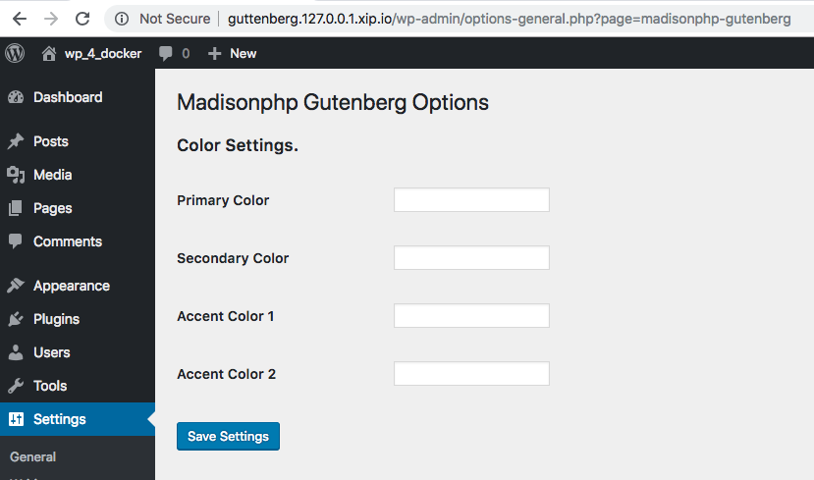
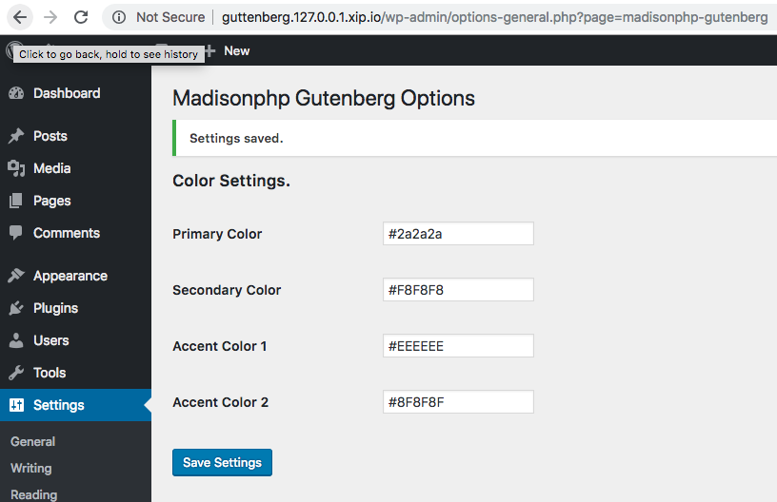
Options

Slide 35
Options – Validation/Sanitize
register_setting(
'madisonphp_gutenberg’,
'madisonphp_gutenberg_options’,
array('sanitize_callback’ => 'madison_gutenberg_validate_color_options’
)
);

Slide 36
Options – Validate function
function madison_gutenberg_validate_color_options($args)
{
foreach($args as $key => $color)
{
$args[$key] = madison_gutenberg_validate_color($color,$key);
}
return $args;
}

Slide 37
Options - Submited Args
Array (
[madisonphp_gutenberg_field_primary_color] => #2a2a2a
[madisonphp_gutenberg_field_secondary_color] => #f8f8f8
[madisonphp_gutenberg_field_accent_1_color] => tyioahwe
[madisonphp_gutenberg_field_accent_2_color] =>
)

Slide 38
Options Sanitize
function madison_gutenberg_validate_color($color,$key)
{
if(!empty($color))
{
if(preg_match('/^#(?:[0-9a-fA-F]{3}){1,2}$/',$color))
{
return $color;
}else {
$message = __('Color must be a valid hex color value','madisonphp-gutenberg’);
add_settings_error( 'validator_' . $key, esc_attr( 'settings_updated' ), $message );
return ’’;
}
}
}

Slide 39
Add Setting Error
add_settings_error(
$setting,
$code,
$message,
$type )
Slug title of the setting to which this error applies
Slug-name to identify the error. Used as part of 'id' attribute in HTML output.
The formatted message text to display to the user
The type of message it is.
error
updated

Slide 40
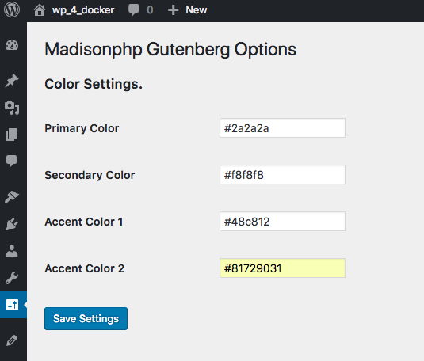
Options – Bad value

Slide 41
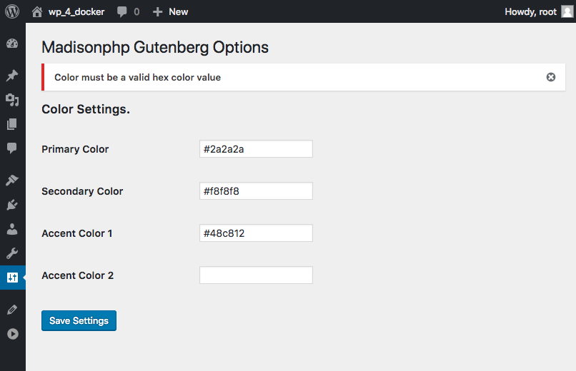
Options - Error

Slide 42
Custom Colors to CSS
function madisonphp_gutenberg_add_custom_colors(){
wp_enqueue_style( 'madisonphp-gutenberg', plugins_url( '/css/madisonphp-gutenberg.css', __FILE__ ),array(), '1.2');
$colors = get_option('madisonphp_gutenberg_options');
ob_start();
foreach($colors as $key => $color) {
if(!empty($color)) {
switch($key) {
case 'madisonphp_gutenberg_field_primary_color':
$color_name = "primary-color";
break;
case 'madisonphp_gutenberg_field_secondary_color':
$color_name = "secondary-color";
break;
case 'madisonphp_gutenberg_field_accent_1_color':
$color_name = "accent-1-color";
break;
case 'madisonphp_gutenberg_field_accent_2_color':
$color_name = "accent-2-color";
break;
}
echo '.has-' . $color_name . '-color { color: '. $color . '; }’;
echo '.has-' . $color_name .
'-background-color { background-color: '. $color . '; }';
}
}
$custom_css = ob_get_contents();
ob_end_clean();
wp_add_inline_style( 'madisonphp-gutenberg', $custom_css );
}
add_action( 'wp_enqueue_scripts’, 'madisonphp_gutenberg_add_custom_colors' );

Slide 43
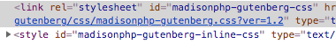
Custom Color CSS output
<style id="madisonphp-gutenberg-inline-css" type="text/css">
.has-primary-color-color { color: #2a2a2a; }
.has-primary-color-background-color { background-color: #2a2a2a; }
.has-secondary-color-color { color: #f8f8f8; }
.has-secondary-color-background-color { background-color: #f8f8f8; }
.has-accent-1-color-color { color: #48c812; }
.has-accent-1-color-background-color { background-color: #48c812; }
.has-accent-2-color-color { color: #817290; }
.has-accent-2-color-background-color { background-color: #817290; }
</style>

Slide 44
Options – Adding custom to Palette
function madison_gutenberg_color_palette() {
$colors = get_option('madisonphp_gutenberg_options');
$palette_colors = array();
foreach($colors as $key => $color) {
if(!empty($color)) {
switch($key){
case 'madisonphp_gutenberg_field_primary_color’:
$color_name = "Primary Color";
$color_slug = "primary-color";
break;
case 'madisonphp_gutenberg_field_secondary_color’:
$color_name = "Secondary Color";
$color_slug = "secondary-color";
break;

Slide 45
case 'madisonphp_gutenberg_field_accent_1_color’:
$color_name = "Accent 1 Color";
$color_slug = "accent-1-color";
break;
case 'madisonphp_gutenberg_field_accent_2_color’:
$color_name = "Accent 2 Color";
$color_slug = "accent-2-color";
break;
default:
$color_name = "";
$color_slug = "";
break;
} //End Switch for setting names
if(!empty($color_name)) {
$palette_colors[] = array(
'name' => esc_html__( $color_name, 'madisonphp-gutenberg’),
'slug' => $color_slug,
'color' => $color,
}// End if we need to add it to the palette
} // End if color is not empty
} // End foreach Option

Slide 46
if(!empty($palette_colors)){
add_theme_support( 'editor-color-palette', $palette_colors );
}//End if we have colors reset palette to them
}//End function madison_gutenberg_color_palette

Slide 47
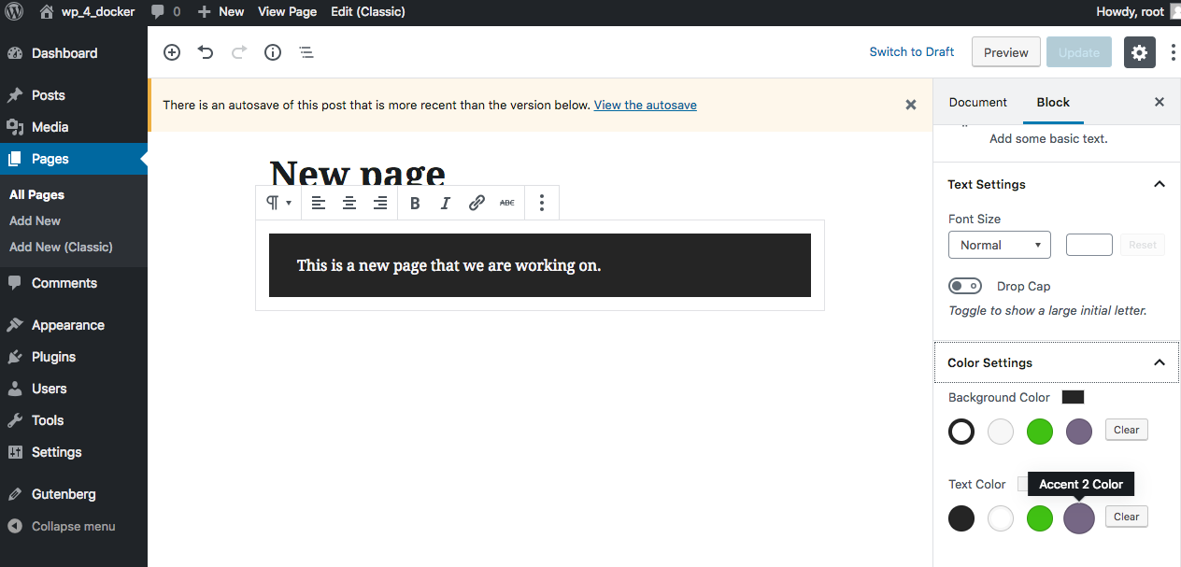
Options - Results

Slide 48
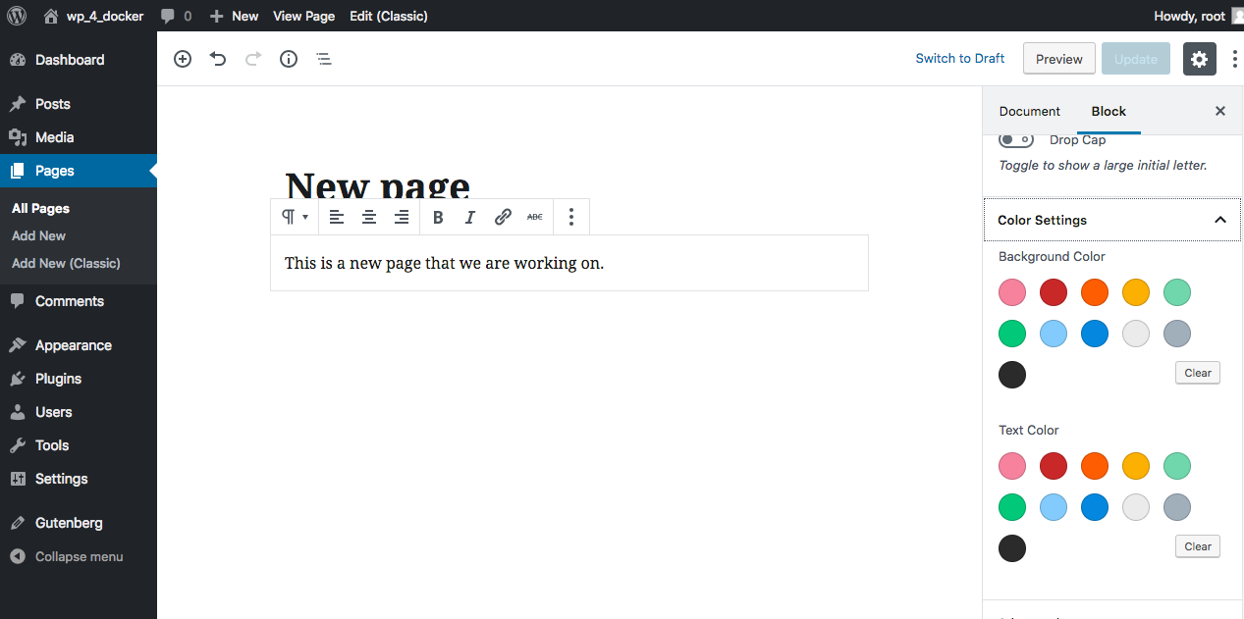
No Options filled out

Slide 49
Options – Another page?
Add new submenu page: madisonphp_gutenberg_options_page
add_submenu_page
Adding to the: madisonphp_gutenberg_settings_init
register_setting
add_settings_section
add_settings_field
Add the needed callbacks for each of the functions

Slide 50
Demo – Additionial Options Page

Slide 51
Javascript
wp_register_script(
string $handle,
string $src,
array $deps = array(),
string|bool|null $ver = false,
bool $in_footer = false
)
wp_enqueue_script(
string $handle,
string $src = ’’,
array $deps = array(),
string|bool|null $ver = false,
bool $in_footer = false
)
Notes:
You can Register a script but not include it.
If a registered Script is in the deps Array it will be included.

Slide 52
Custom Post Types
register_post_type(
string $post_type,
array $args = array()
);
Post type. (max. 20 characters, cannot contain capital letters or spaces)

Slide 53
CPT - Args
(string) label
(array) labels
name
singular_name
add_new
add_new_item
edit_item
new_item
view_item
view_items
search_items
not_found
not_found_in_trash
parent_item_colon
all_items
archives
attributes
insert_into_item
uploaded_to_this_item
featured_image
set_featured_image
remove_featured_image
use_featured_image
menu_name
filter_items_list
items_list_navigation
items_list
name_admin_bar
Notes:
name' - general name for the post type, usually plural. The same and overridden by $post_type_object->label. Default is Posts/Pages
'singular_name' - name for one object of this post type. Default is Post/Page
'add_new' - the add new text. The default is "Add New" for both hierarchical and non-hierarchical post types. When internationalizing this string, please use a gettext context matching your post type. Example: _x('Add New', 'product');
'add_new_item' - Default is Add New Post/Add New Page.
'edit_item' - Default is Edit Post/Edit Page.
'new_item' - Default is New Post/New Page.
'view_item' - Default is View Post/View Page.
'view_items' - Label for viewing post type archives. Default is 'View Posts' / 'View Pages'.
'search_items' - Default is Search Posts/Search Pages.
'not_found' - Default is No posts found/No pages found.
'not_found_in_trash' - Default is No posts found in Trash/No pages found in Trash.
'parent_item_colon' - This string isn't used on non-hierarchical types. In hierarchical ones the default is 'Parent Page:'.
'all_items' - String for the submenu. Default is All Posts/All Pages.
'archives' - String for use with archives in nav menus. Default is Post Archives/Page Archives.
'attributes' - Label for the attributes meta box. Default is 'Post Attributes' / 'Page Attributes'.
'insert_into_item' - String for the media frame button. Default is Insert into post/Insert into page.
'uploaded_to_this_item' - String for the media frame filter. Default is Uploaded to this post/Uploaded to this page.
'featured_image' - Default is Featured Image.
'set_featured_image' - Default is Set featured image.
'remove_featured_image' - Default is Remove featured image.
'use_featured_image' - Default is Use as featured image.
'menu_name' - Default is the same as `name`.
'filter_items_list' - String for the table views hidden heading.
'items_list_navigation' - String for the table pagination hidden heading.
'items_list' - String for the table hidden heading.
'name_admin_bar’ - String for use in New in Admin menu bar. Default is the same as `singular_name`.

Slide 54
CPT – Args
(string) description
(bool) public
(bool) exclude_from_search
(bool) publicly_queryable
(bool) show_ui
(bool) show_in_nav_menus
(bool/string) show_in_menu
(bool) show_in_admin_bar
(int) menu_position
(string) menu_icon
(array) capability_type
(array) capabilities
(bool) map_meta_ cap
(bool) hierarchical
(array/bool) supports
(callback) register_meta_box_cb

Slide 55
CPT - Args
(array) taxonomies
(bool/string) has_archive
(bool/array) rewrite
(string) permalink_epmask
(bool/string) query_var
(bool) can_export
(bool) delete_with_user
(bool) show_in_rest
(string) rest_base
(string) rest_controller_class
https://codex.wordpress.org/Function_Reference/register_post_type

Slide 56
CPT - Example
register_post_type( 'news',
array(
'labels' => array(
'name' => __( 'News Articles' ),
'singular_name' => __( 'News Article' ),
'add_new' => __( 'Add New News Article' ),
'add_new_item' => __( 'Add New News Article' ),
'new_item' => __( 'New News Article' ),
'edit_item' => __( 'Edit News Article' ),
'view_item' => __( 'View News Article' ),
'all_items' => __( 'All News Articles' ),
'search_items' => __( 'Search News Articles' ),
'parent_item_colon' => __( 'Parent News Articles:' ),
'not_found' => __( 'No news articless found.' ),
'not_found_in_trash' => __( 'No news articles found in trash.’ )
),

Slide 57
CPT - Example
'public' => true,
'show_in_rest' => true,
'rewrite' => array(
'slug' => 'about/news',
'with_front' => false
),
'supports' => array(
'title’,
'editor’,
'revisions',
'thumbnail’,
),

Slide 58
CPT – Example - Gutenberg
'template' => array(
array( 'core/paragraph', array(
'placeholder' => 'Add News...',
) ),
array( 'core/heading', array(
'placeholder' => 'Add Author...',
) ),
array( 'core/image', array(
'align' => 'left',
) ),
array( 'core/paragraph', array(
'placeholder' => 'Add About Author...',
) ),
),
'template_lock' => 'insert',

Slide 59
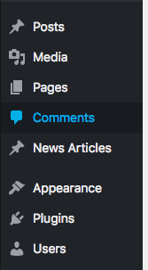
News Post type

Slide 60
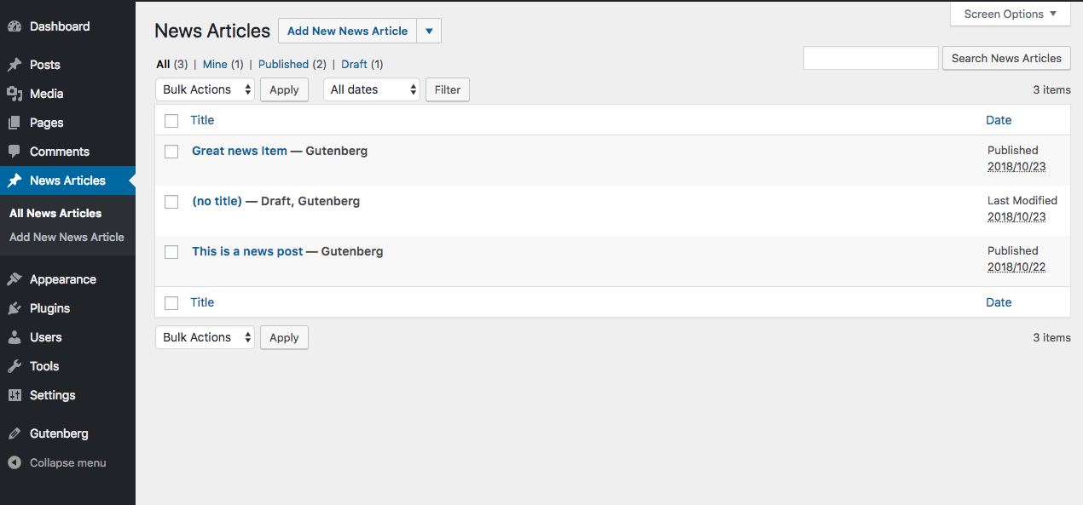

Slide 61
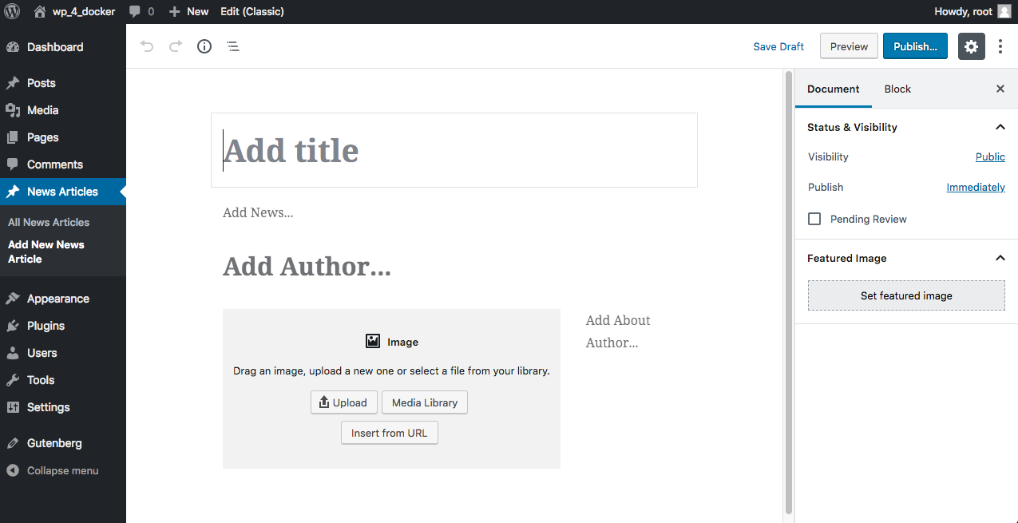

Slide 62
Getting into the Wordpress Directory
Track basic stats regarding how many people are downloading and when
Provide a centralized location for users to leave comments and feedback
Get your plugin rated against the many other hosted WordPress plugins
And of course, give your plugin greater exposure to the WP community

Slide 63
Steps to add to WP directory
Write and prepare your plugin
Prepare the plugin readme.txt file
Sign up for access to the Subversion Repository
Wait for approval and SVN access information
Use Subversion to upload your plugin files
Wait a few minutes for the system to add your plugin to the Plugin Directory

Slide 64
Readme.txt
Plugin Name
Description
Installation
Faq
Screenshots
Other Notes
Changelog
Stats
Admin

Slide 65
Readme.txt
=== Plugin Name ===
Contributors: (plugin contributors)
Plugin Name: (name of your plugin)
Plugin URI: (web page for plugin)
Tags: (tags for the plugin)
Author URI: (plugin authors site)
Author: (the plugin's author)
Donate link: (a link for donating)
Requires at least: (minimum required WP)
Tested up to: (tested WP up to ver)
Stable tag: (plugin's stable ver)
Version: (plugins current ver)
== Description ==
== Installation ==

Slide 66
Helpful links
https://codex.wordpress.org/Writing_a_Plugin
https://codex.wordpress.org/Plugin_API/Action_Reference - Actions List
https://adambrown.info/p/wp_hooks/hook - All Hooks list
http://php.net/manual/en/function.version-compare.php - PHP version compare
https://developer.wordpress.org/plugins/settings/custom-settings-page/ - setting page
https://stackoverflow.com/questions/1636350/how-to-identify-a-given-string-is-hex-color-format - Regex for Hex Color

Slide 67

Questions?

Slide 68
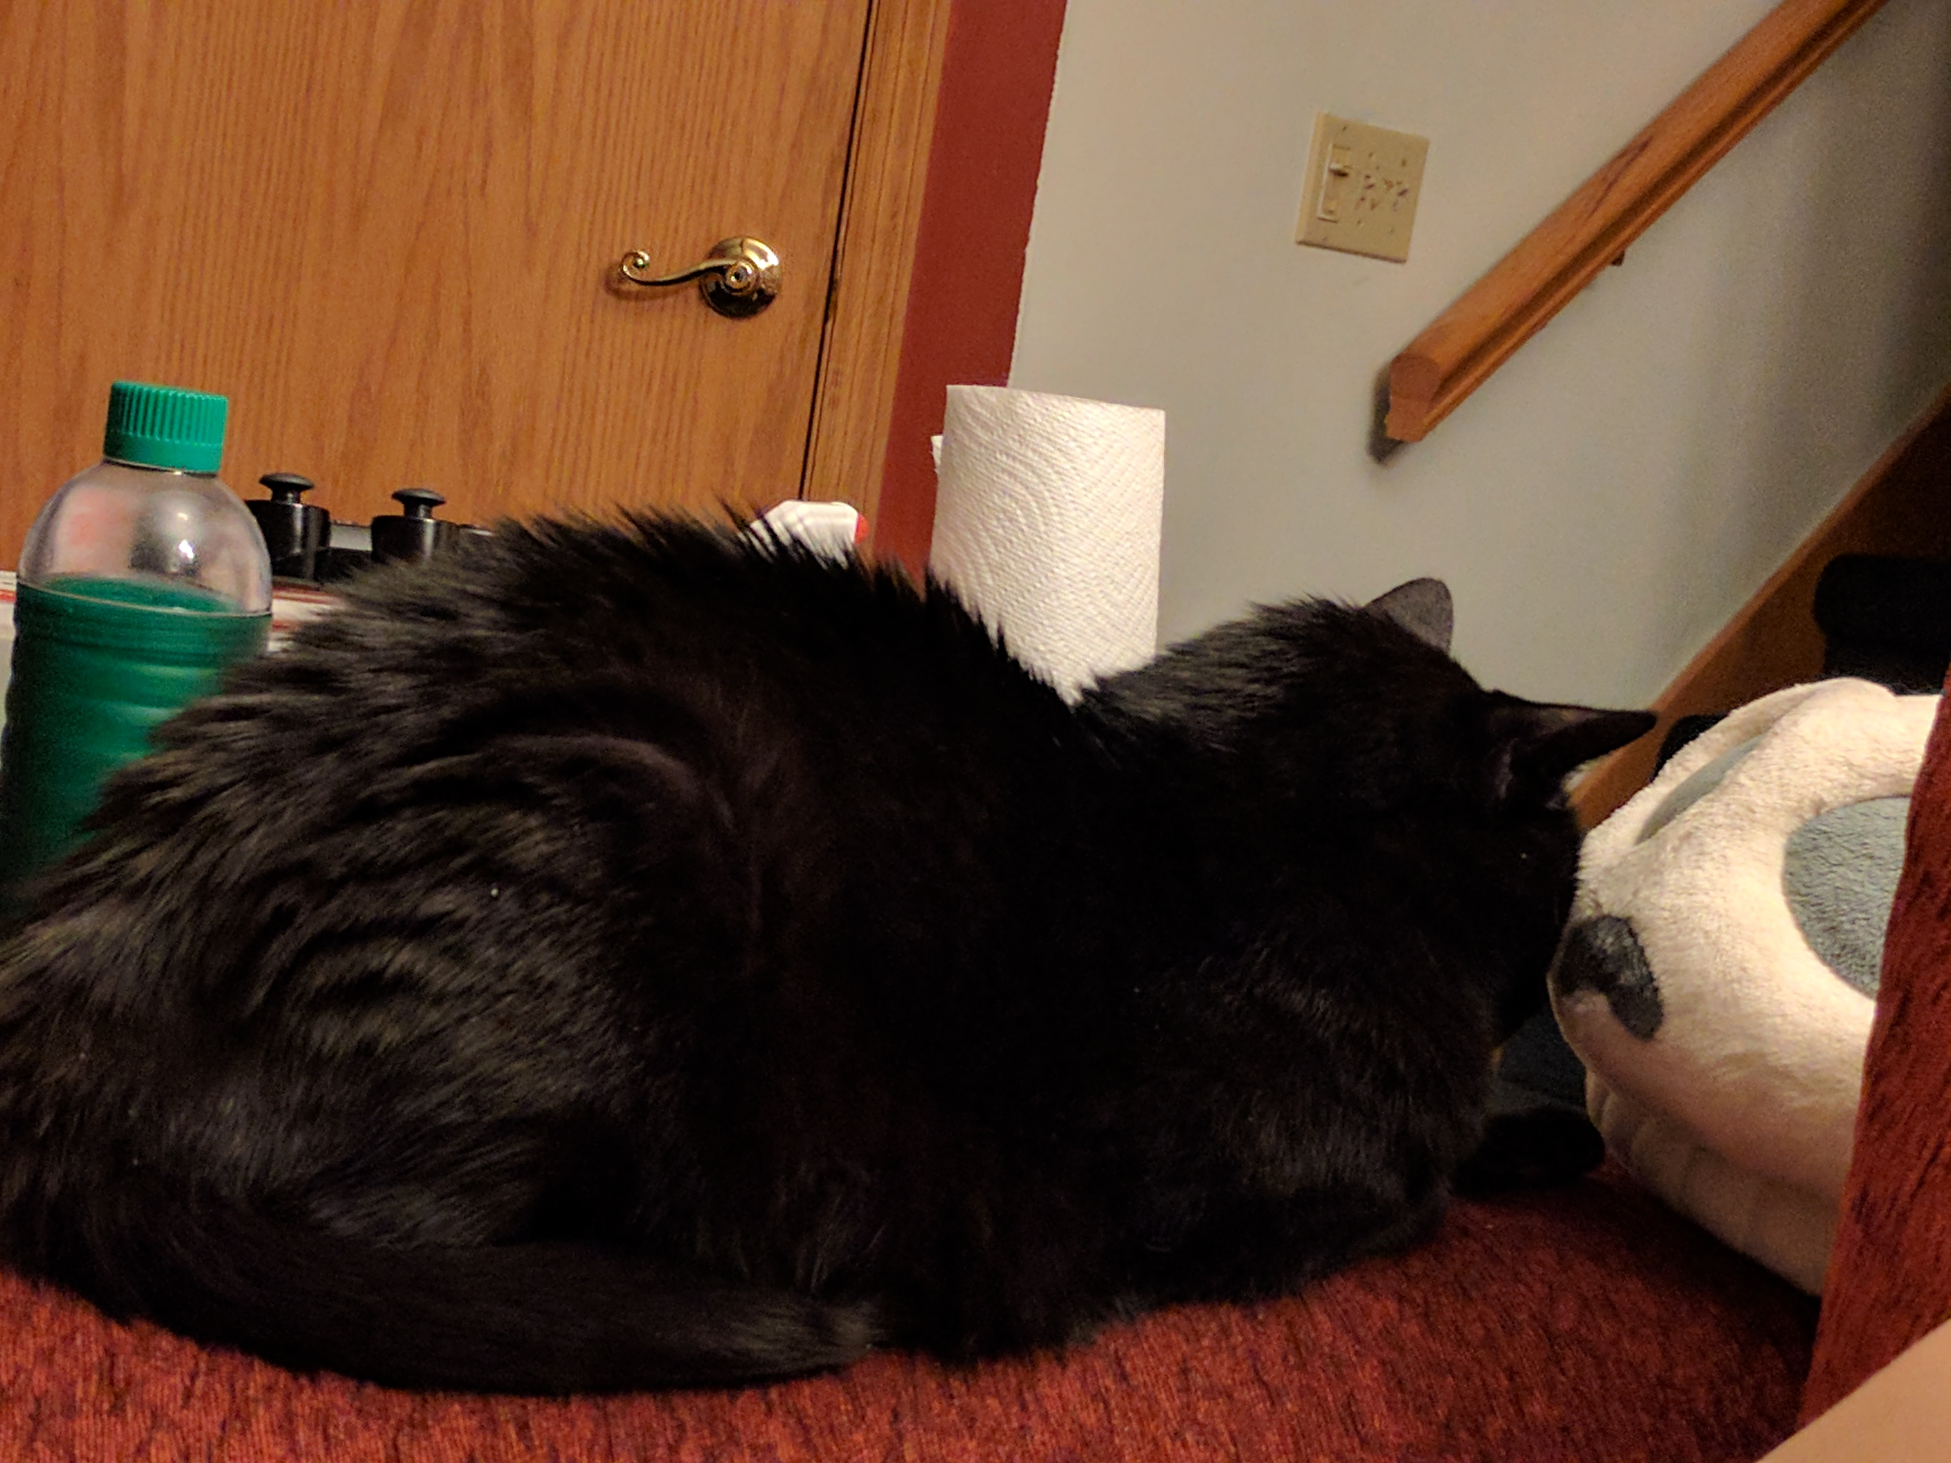
Thanks for your time
Daniel Greig
greig@earthlinginteractive.com

